Slide 1
Easy-Deploy (ED), deploy your applications in Kubernetes.
Zach Chih, Advantech

Slide 2
Outline
WHY
WHERE/WHAT/HOW
Easy-Deploy (ED)
Private Repository
Helm
Discovery & Search
Comparison
Delivery

Slide 3


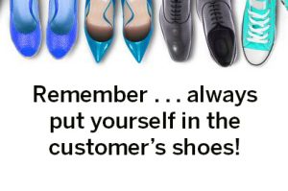
Always In Customer’s shoes

Slide 4
WHY – What’ll we face?
No matter which delivery the customers choose, standard or custom.
One day, we will re-deploy applications (maintain/upgrade) ……
One day, customers will want to host their applications (helm charts)……
One day, customers will want to deploy their applications ……
One day, customers will want to upgrade their applications ……

Slide 5
WHERE/WHAT/HOW – Questions in mind
Where’s the space for my applications (helm charts)?
What applications could I have and deploy?
How could I deploy and upgrade application quickly and easily?
  Use command line? It’s okay! But not cool!

Slide 6
Easy-Deploy (ED)
Easy-Deploy (ED), as you could tell from its name, you could deploy applications very easily!!

Slide 7
Easy-Deploy (ED)
A great deal of official and public applications
Private Repository for your applications
Management Dashboard
One-Click management (deploy/upgrade/remove)

Slide 8

Private Repository
ChartMuseum
  an open-source, easy to deploy,
  Helm Chart Repository server.

Slide 9
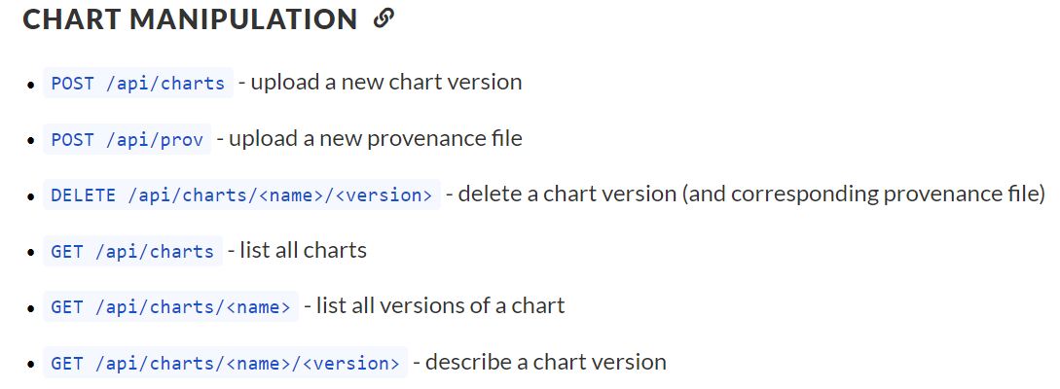
Private Repository
Upload Applications
  Restful API
  Helm

Slide 10

Helm
Helm
  Making container-based applications easier to deploy on Kubernetes.
  creating a package manager for Kubernetes applications.
  make installing new applications on Kubernetes as easy as running helm install <chart-name>.

Slide 11
Helm
Problem?
  discovering available Helm Charts, and important details about them, is not as easy as it could be.

Slide 12


Discovery & Search
Kubeapps is a web-based UI for deploying and managing applications in Kubernetes clusters.

Slide 13
Kubeapps
Browse and deploy Helm charts from chart repositories
Inspect, upgrade and delete Helm-based applications installed in the cluster
Add custom and private chart repositories
Secure authentication and authorization based on Kubernetes Role-Based Access Control

Slide 14
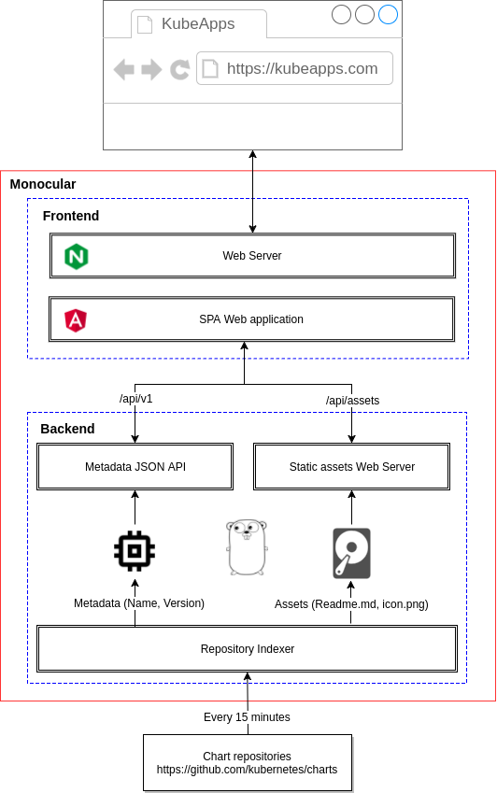
Our Packages
Customer’s Packages
Private repository

Slide 15

Well…. So how it looks like?

Slide 16
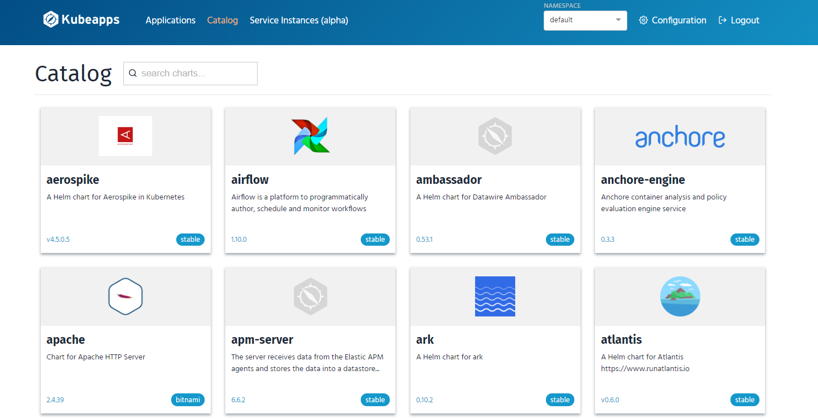

Slide 17
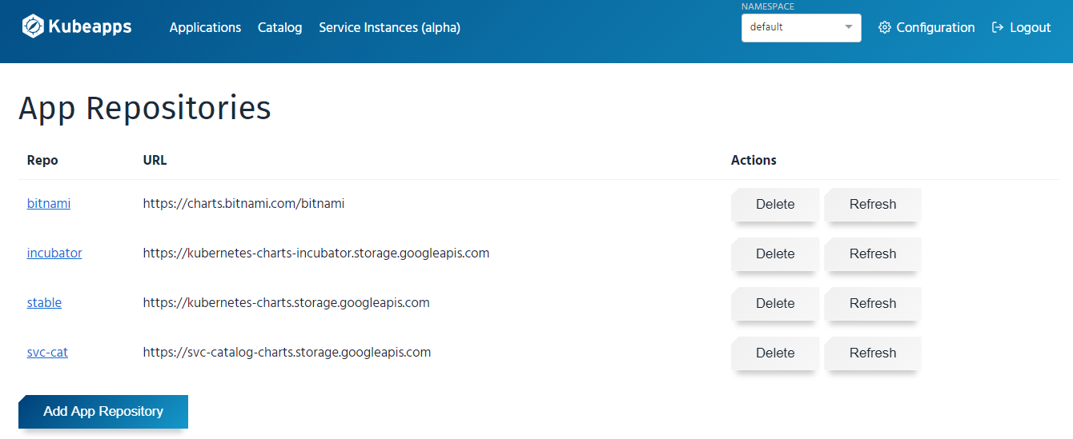

Slide 18
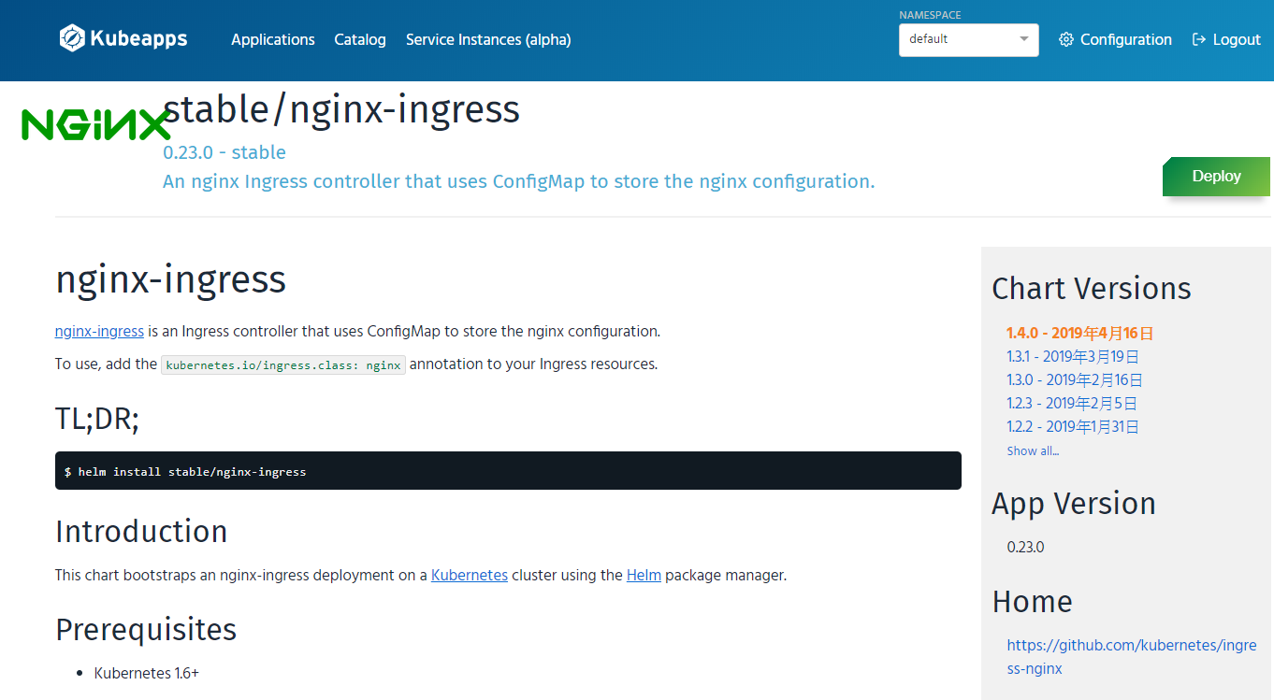

Slide 19
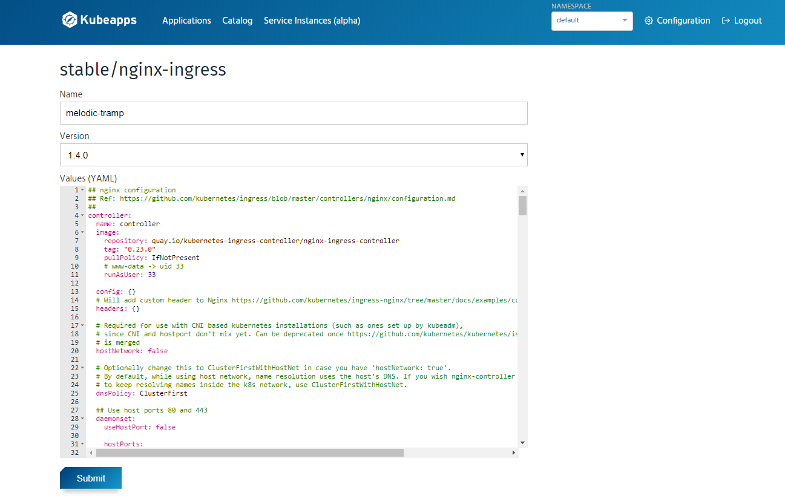

Slide 20
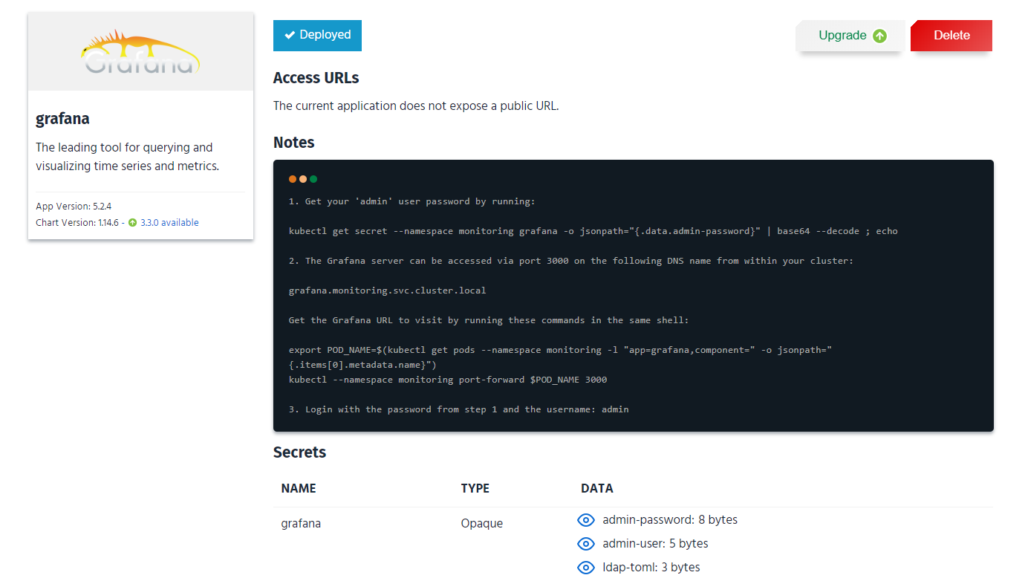

Slide 21
WHERE/WHAT/HOW – Questions in mind
Where’s the space for my applications (helm charts)?
  Private and Secure Repository
What applications could I have and deploy?
  Explore Plenty of applications from official and public repositories
  Upload your applications and Play with one click
How could I deploy and upgrade application quickly and easily?
  Use command line? It’s okay! But not cool!
  Get addicted to our Fantastic and User-friendly Web-UI!

Slide 22
Comparison
 | Without ED | With ED
Deploy Speed | Slow | Fast (one click)
Upgrade Speed | Slow | Fast (one click)
Find App Detail | Slow | Fast
Discovery/Search | Very Difficult | Very Easy
Repo Integration | Difficult | Easy (one click)
User-Friendly | CLI | WEB-UI
Learning Curve | Long | Short

Slide 23
Delivery
 | 1 Master 1 Node | 1 Master 2 Nodes
Original Packages | V | V
Private Repo | V | V
Kubeapps | X | V

Slide 24
Go Together,
We Go Far and Grow Big

